Slide 1

WIPRO NGA Program – Java full stack - 25VID1947
Capstone Project Presentation –29th Aug
Project Title Here – Task Management System
Presented by – 30685_Sarvesh Morey
www.rpsconsulting.in

Slide 2

Project Statement
The Task Management System is designed to streamline project and task organization for teams and individuals. The system allows users to register and log in securely, ensuring personalized access and accountability. Within the system, tasks can be created to group related tasks together, enabling better organization and tracking of work. Users can create, assign, and manage tasks with defined statuses—pending, in progress, or completed—and track deadlines to ensure timely completion. The system supports full CRUD (Create, Read, Update, Delete) operations for tasks, users providing complete control over project management activities. This application aims to improve productivity, collaboration, and efficient task tracking for teams.
2025 - RPS Consulting all rights reserved

Slide 3
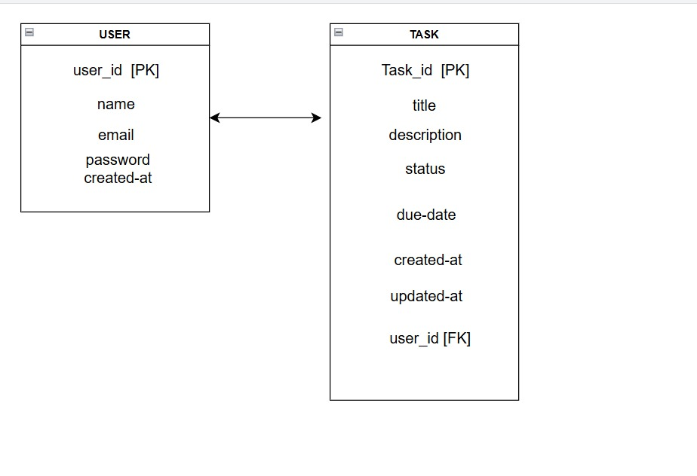
ER Diagram
2025 - RPS Consulting all rights reserved

Slide 4
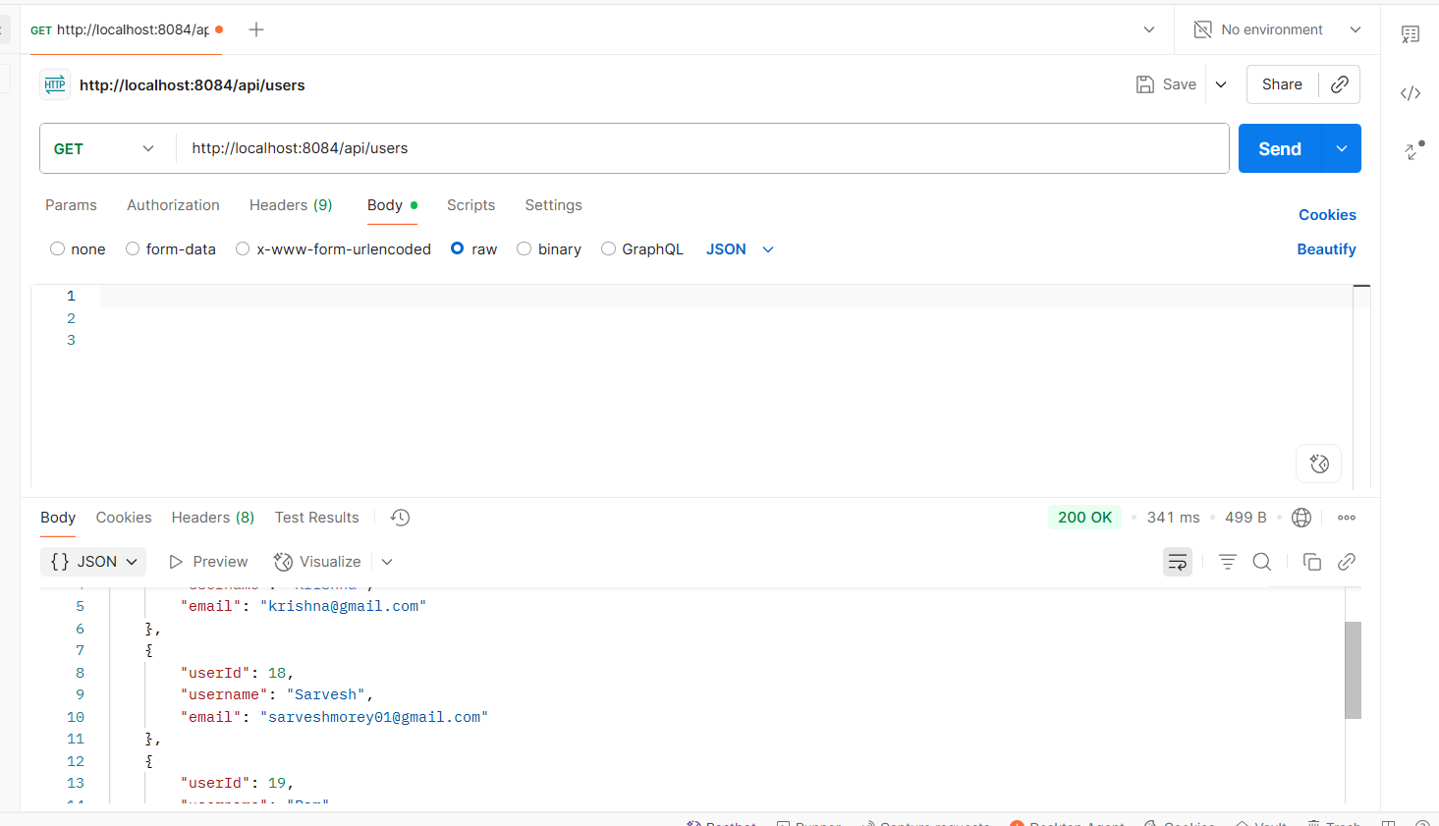
Api Get Users
2025 - RPS Consulting all rights reserved

Slide 5
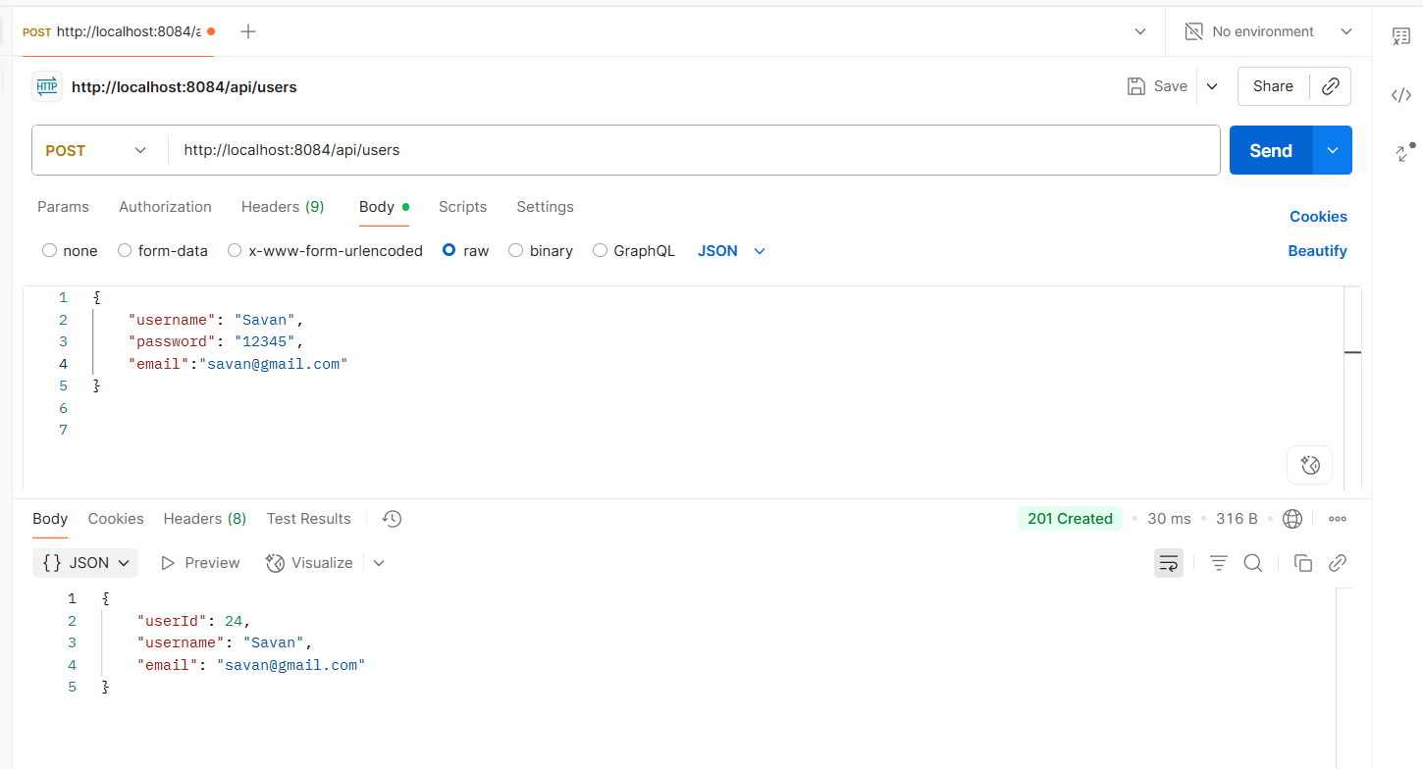
Api Post Users
2025 - RPS Consulting all rights reserved

Slide 6
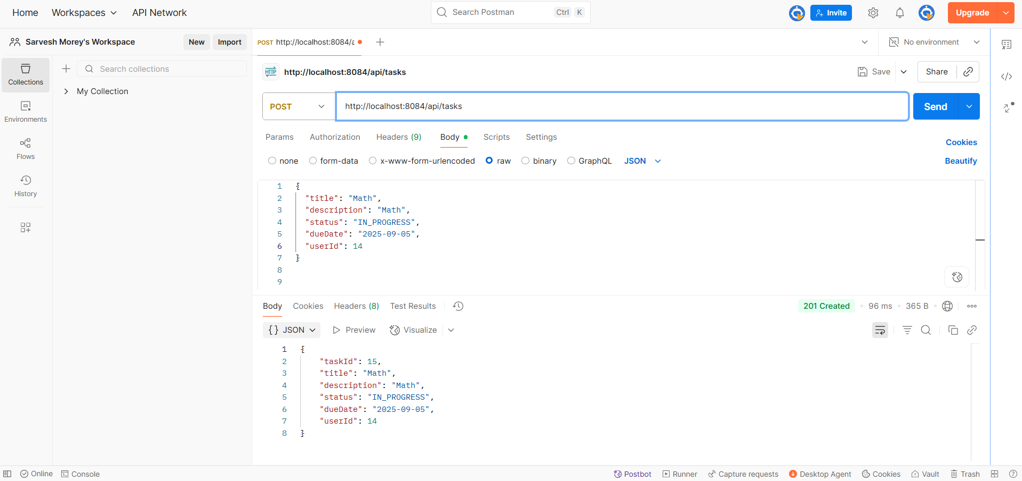
Postman-API Tasks
2025 - RPS Consulting all rights reserved

Slide 7
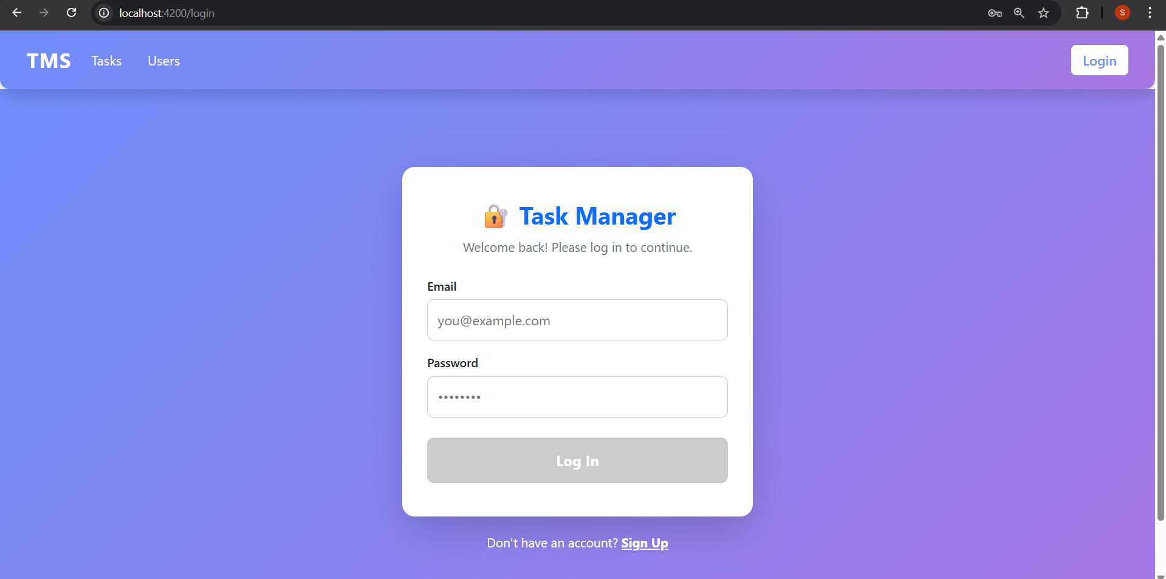
Login Page
2025 - RPS Consulting all rights reserved

Slide 8
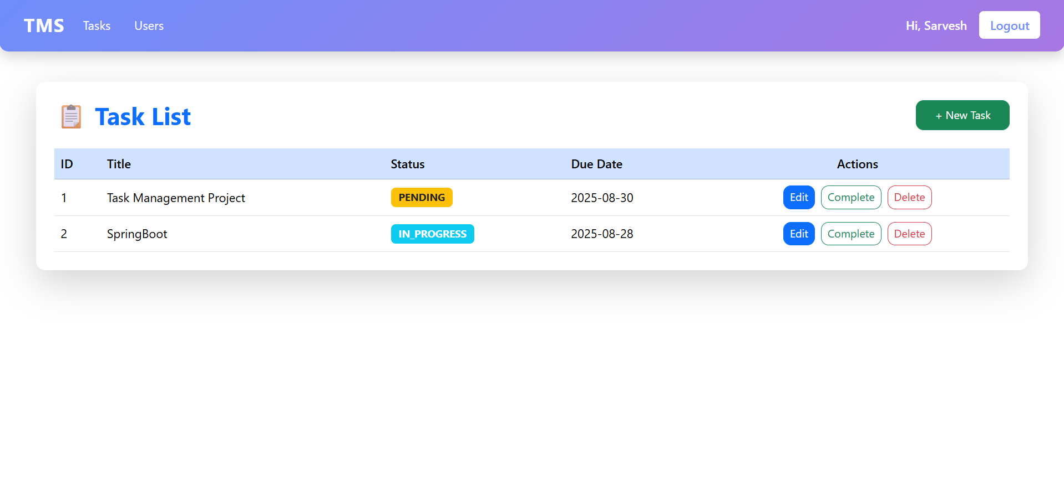
Task List
2025 - RPS Consulting all rights reserved

Slide 9
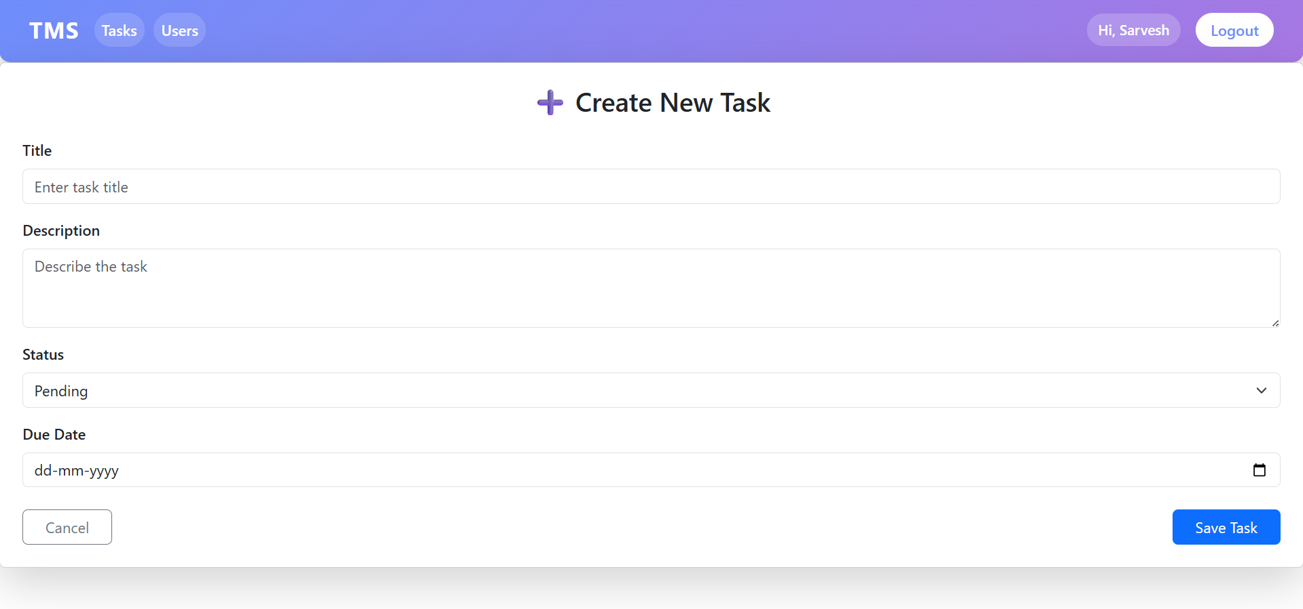
New Task
2025 - RPS Consulting all rights reserved

Slide 10
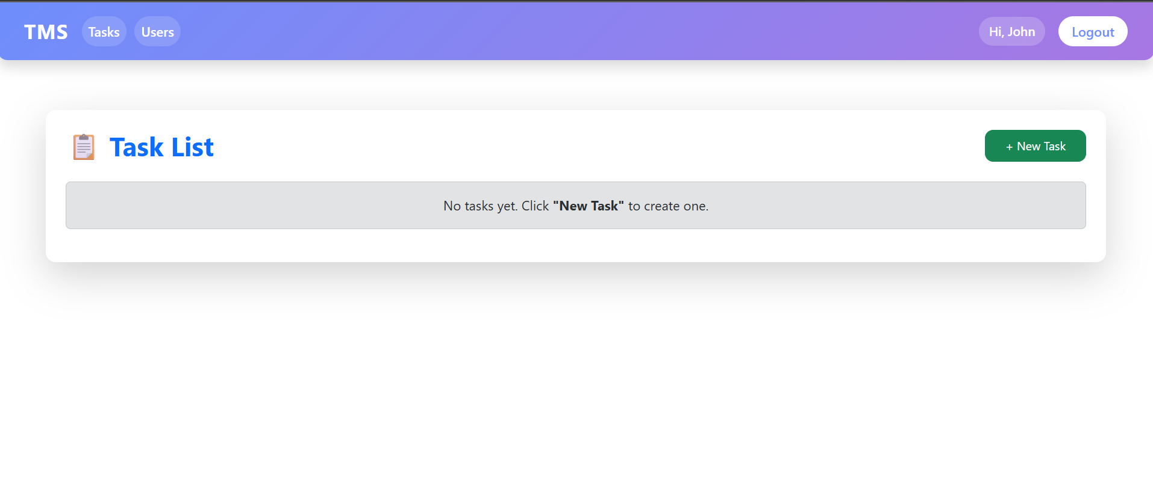
Task List
2025 - RPS Consulting all rights reserved

Slide 11
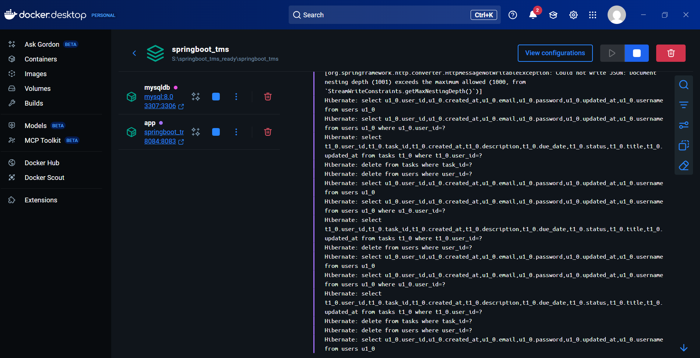
Docker Container
2025 - RPS Consulting all rights reserved

Slide 12
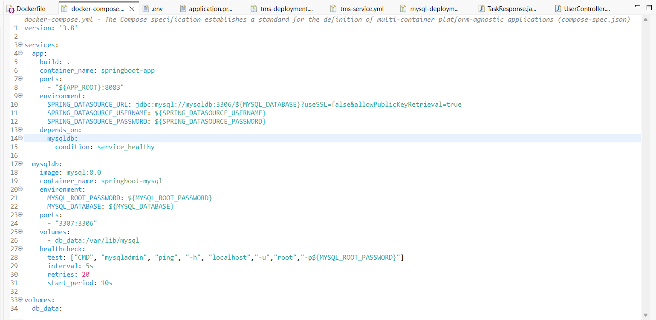

Slide 13
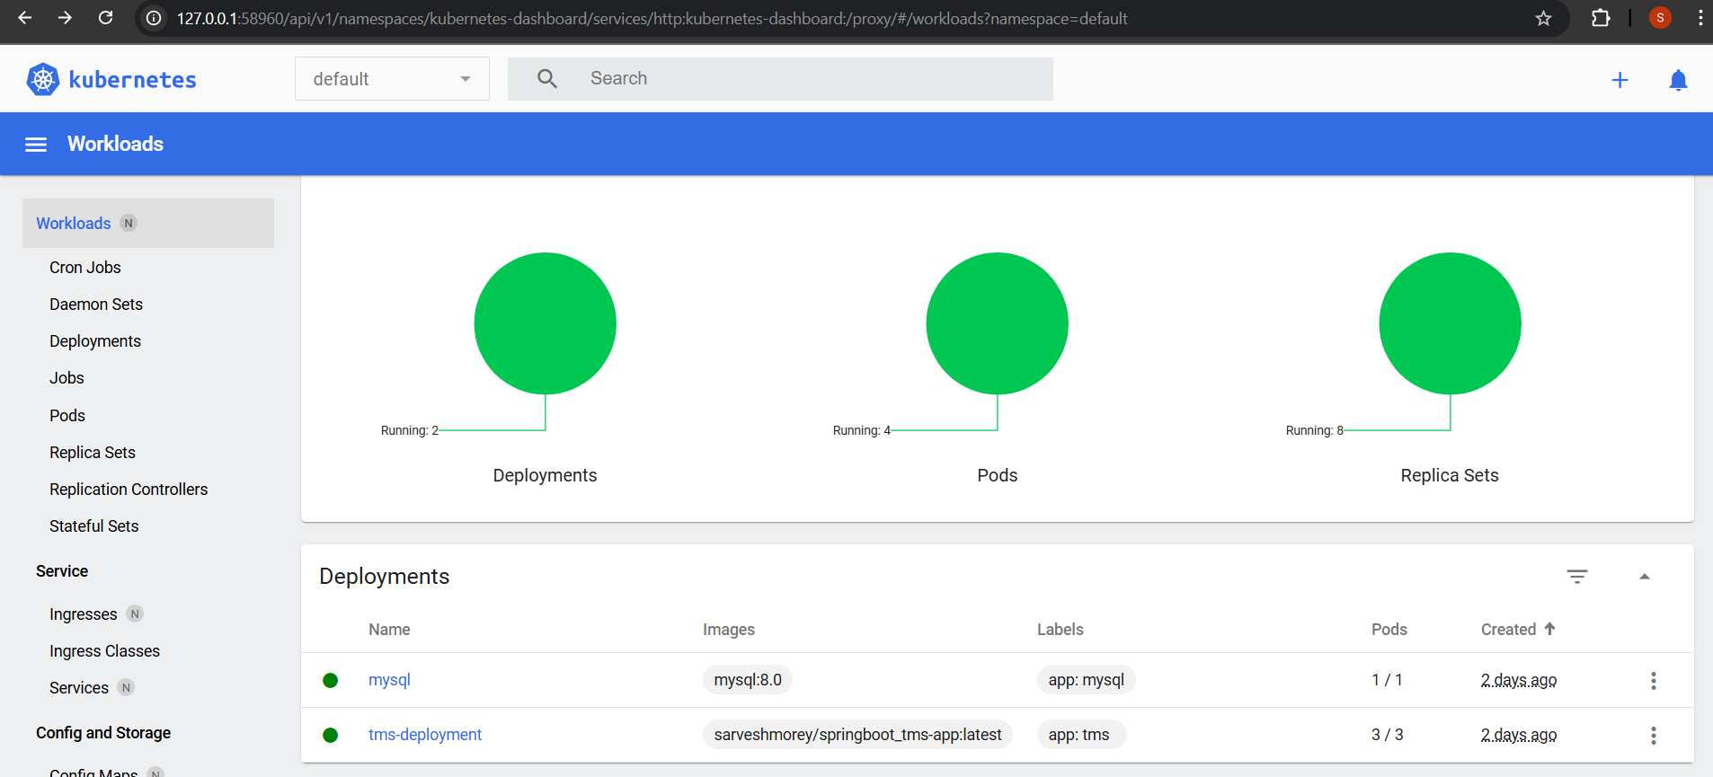
Kubernetes Deployment
2025 - RPS Consulting all rights reserved

Slide 14
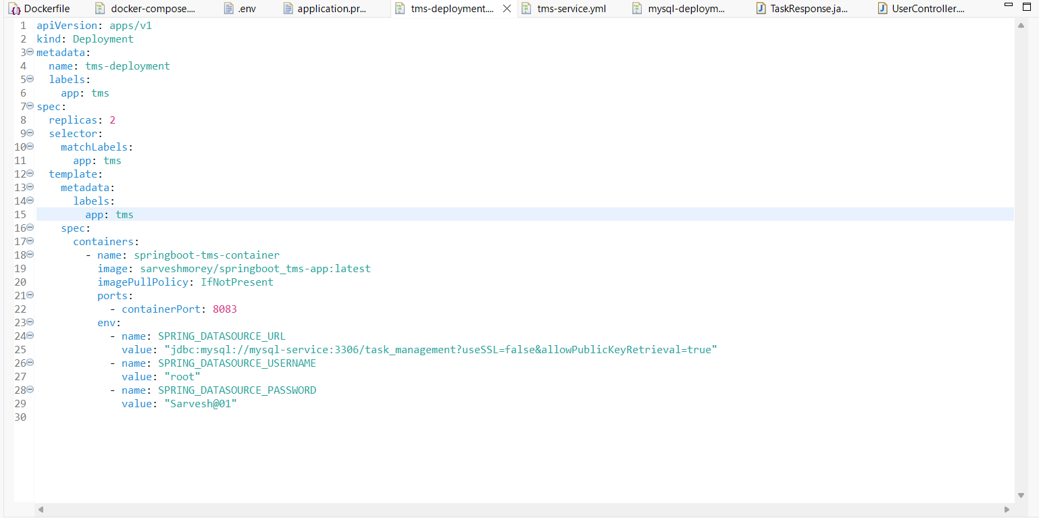

Slide 15
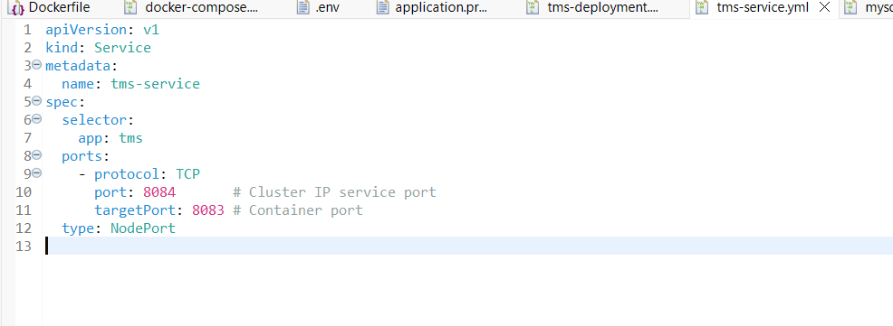

Slide 16
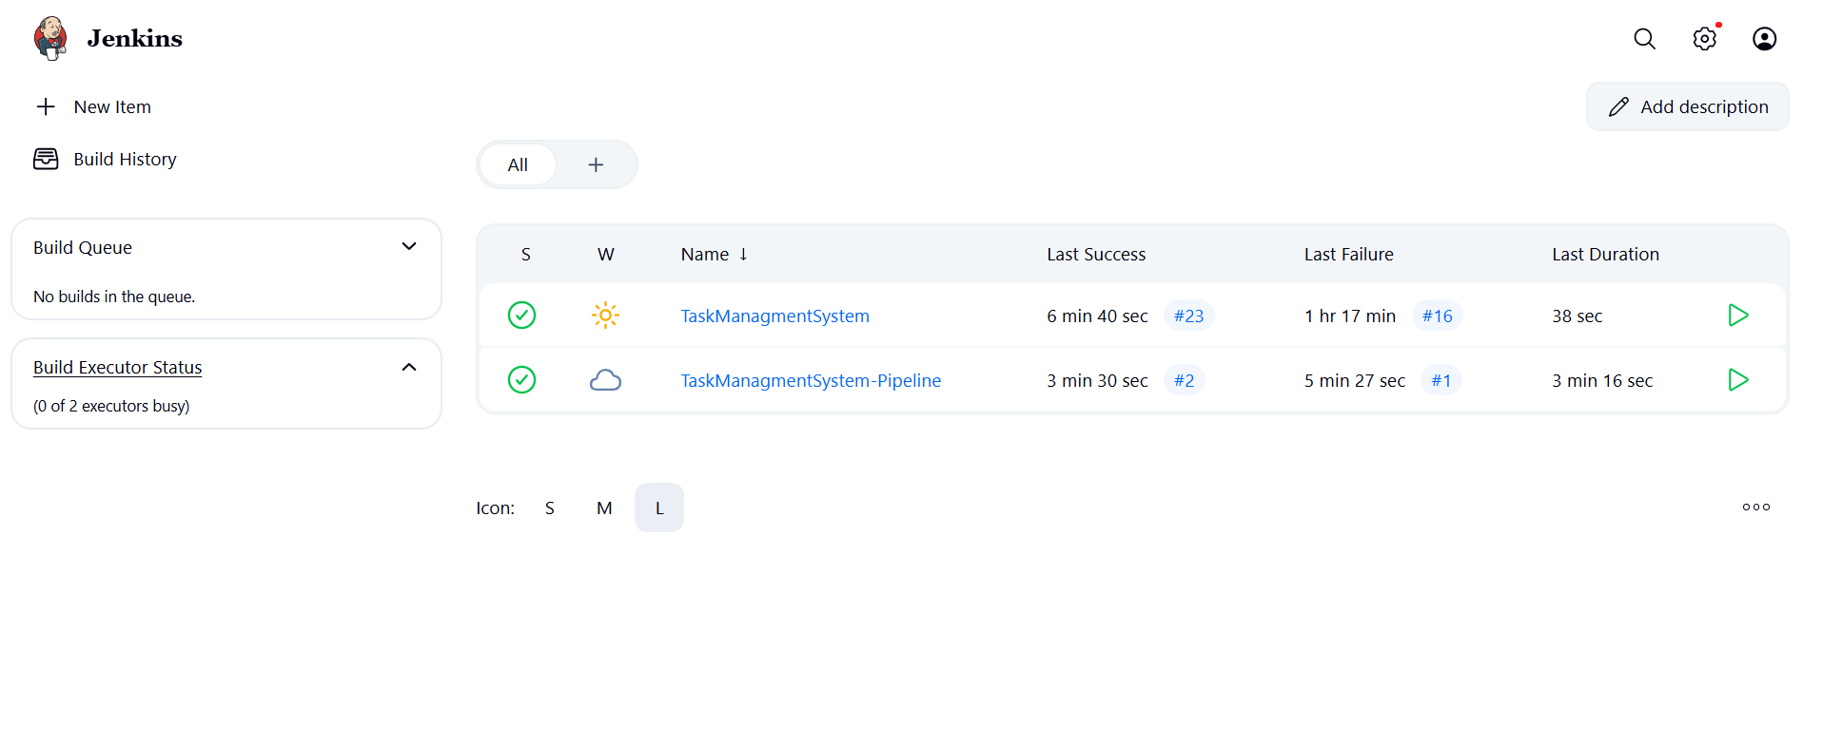
Jenkins
2025 - RPS Consulting all rights reserved

Slide 17
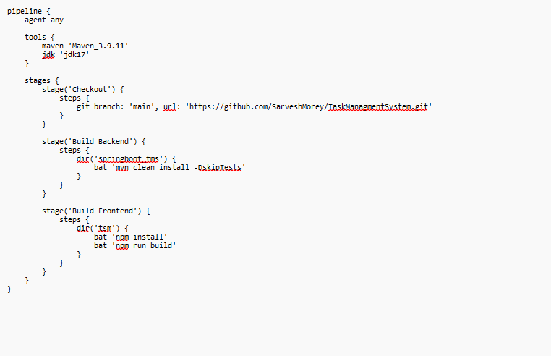
Jenkins
2025 - RPS Consulting all rights reserved

Slide 18
GitHub :- https://github.com/SarveshMorey/TaskManagmentSystem.git
2025 - RPS Consulting all rights reserved

